Slide 1
Analyzing the Demographic Diversity of Volunteer Participation in AmeriCorps
DATS 6101, Group 8
Aidan Carlisle | Sayan Patra | Rachel Thomas | Anusha Umashankar

Slide 2

What is AmeriCorps?
US Federal agency that “brings people together to tackle the country’s most pressing challenges through national service and volunteering.”
AmeriCorps
AmeriCorps NCCC
AmeriCorps State and National
Public Health AmeriCorps
AmeriCorps VISTA
AmeriCorps Seniors
Foster Grandparent Program
RSVP
Senior Companion Program
Senior Demonstration Program

Slide 3
Where is the data from?
Collected and published by AmeriCorps
Provides comparisons of demographic group prevalence in AmeriCorps Member/Volunteers populations to the greater U.S. population
The source dataset consists of about 26000 observations over 17 attributes

Slide 4
Proposed SMART Questions
Which program offices are most effective in engaging a diverse range of participants?
How does the representation of different demographic groups compare to their proportions in the general population?
Which groups are overrepresented or underrepresented in AmeriCorps?
How do participation rates compare between different programs within the same service region?
What is the racial composition of the volunteers?
Are some racial groups more engaged in volunteer activities within specific states?

Slide 5
Important note on Member Service Years (MSYs)
Member service years [MSYs] = the number of days or hours members are required to serve over the course of their term to fulfill their service requirements
Summed and used in place of observed member counts to account for potential differences in service time allotments assigned to different demographic groups

Slide 6
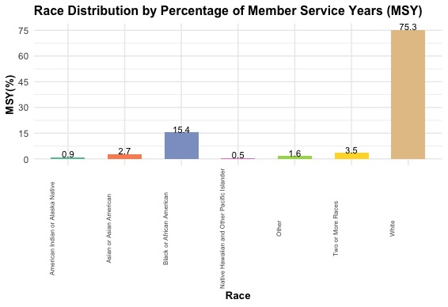
What is the racial composition of the volunteers?

Slide 7
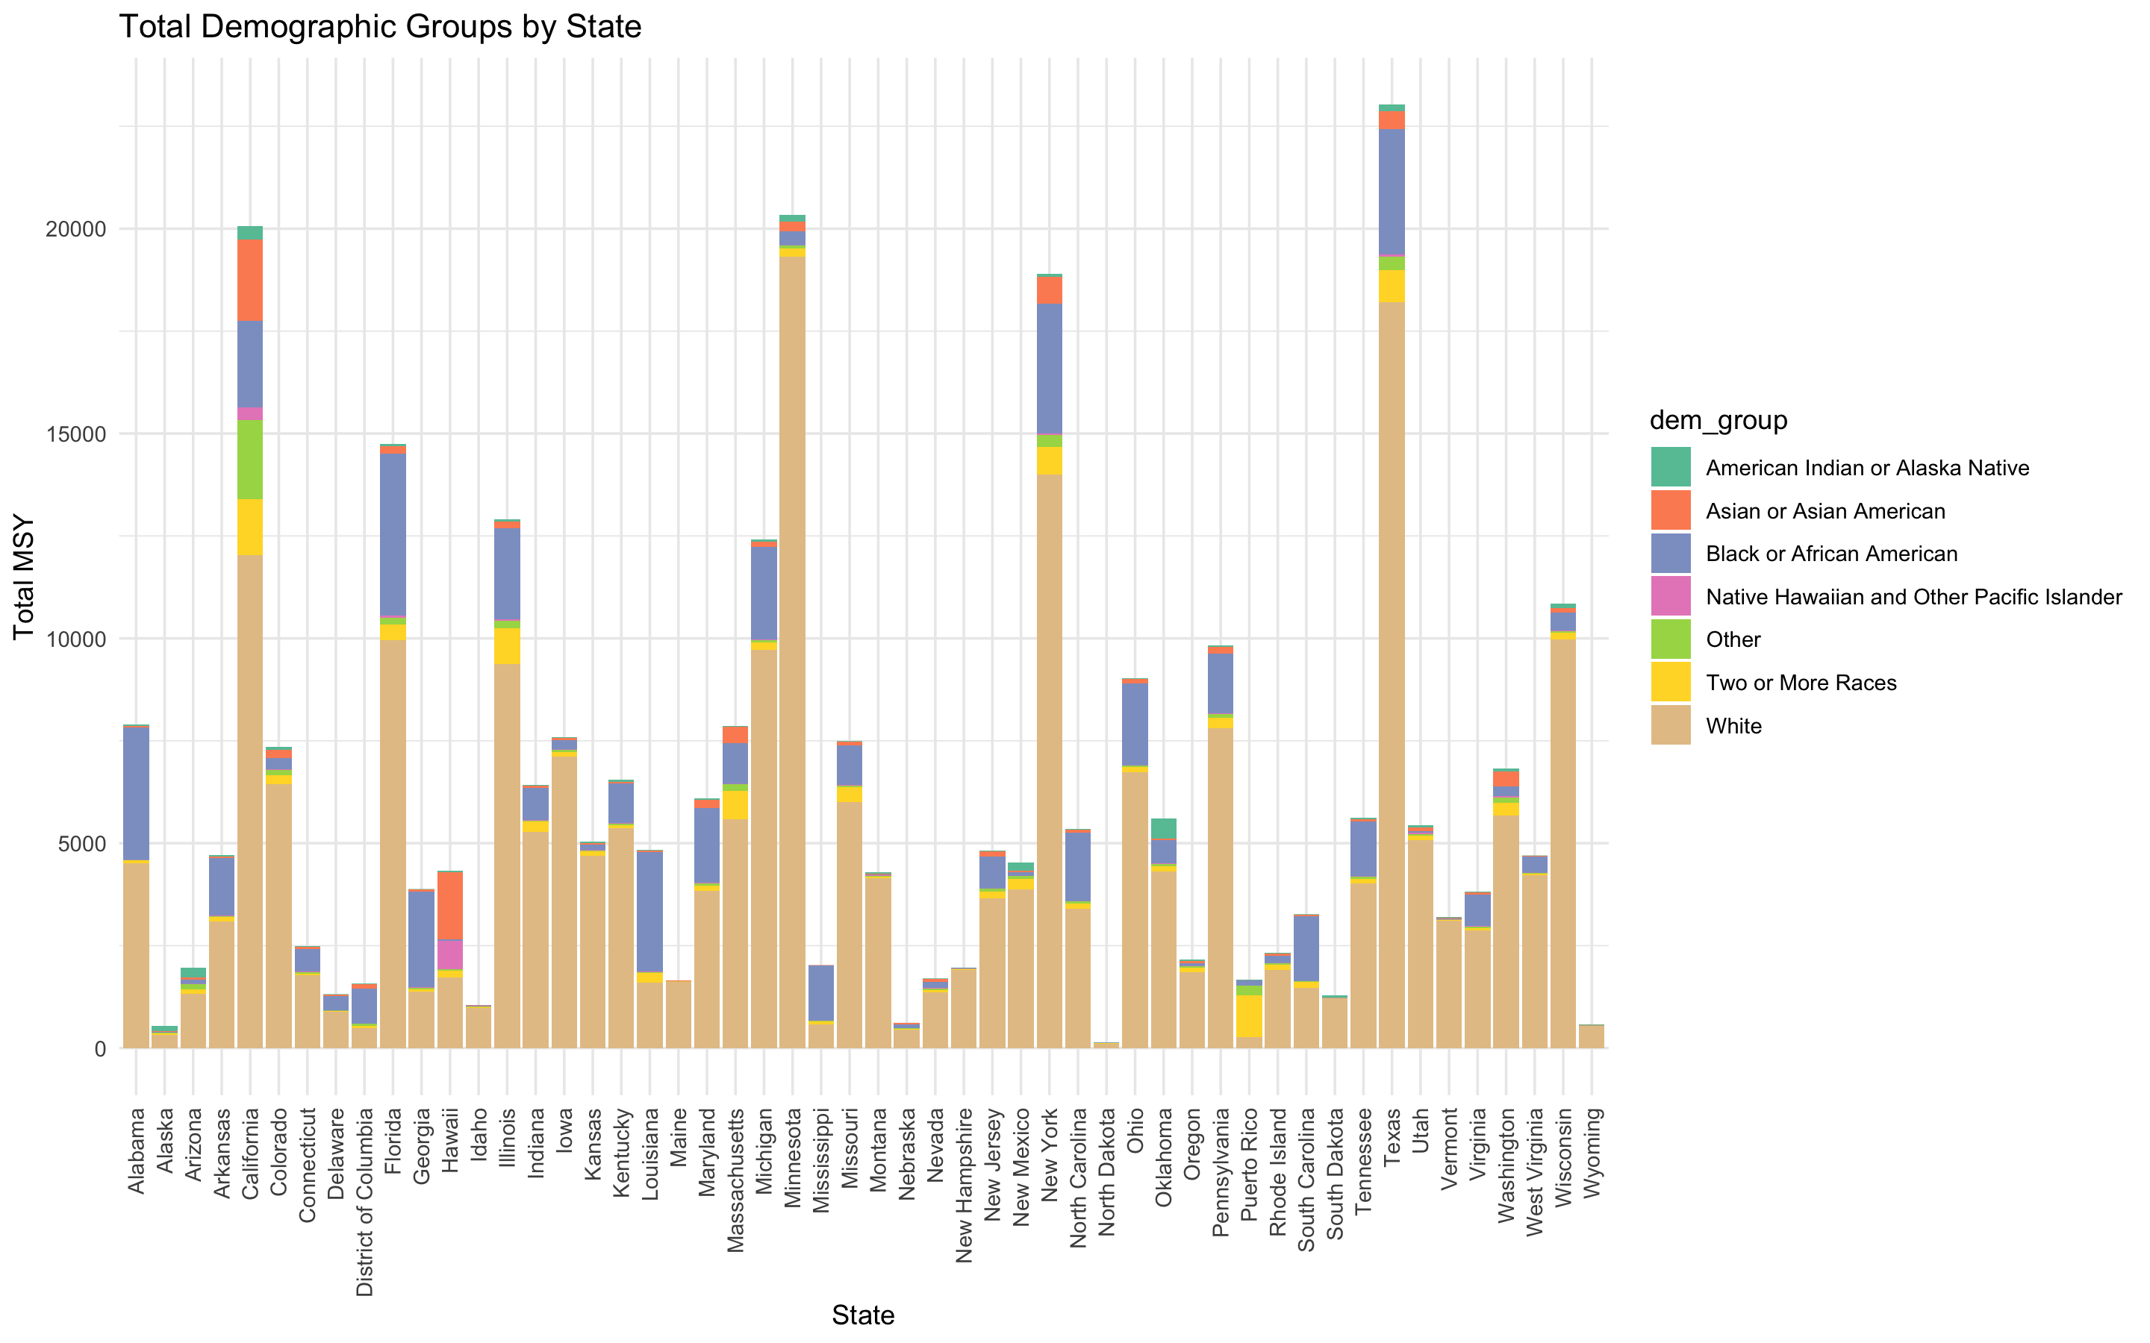
Are some racial groups more engaged in volunteer activities within specific states?

Slide 8
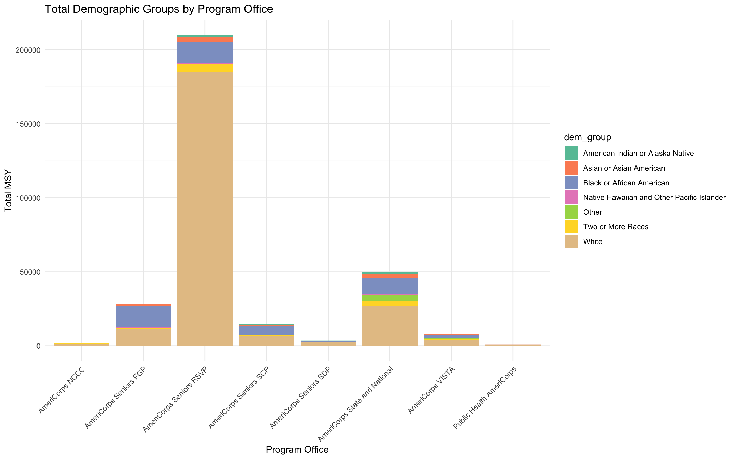
Which program offices are most effective in engaging a diverse range of participants?
Notes:
RSVP has the most volunteers by far

Slide 9
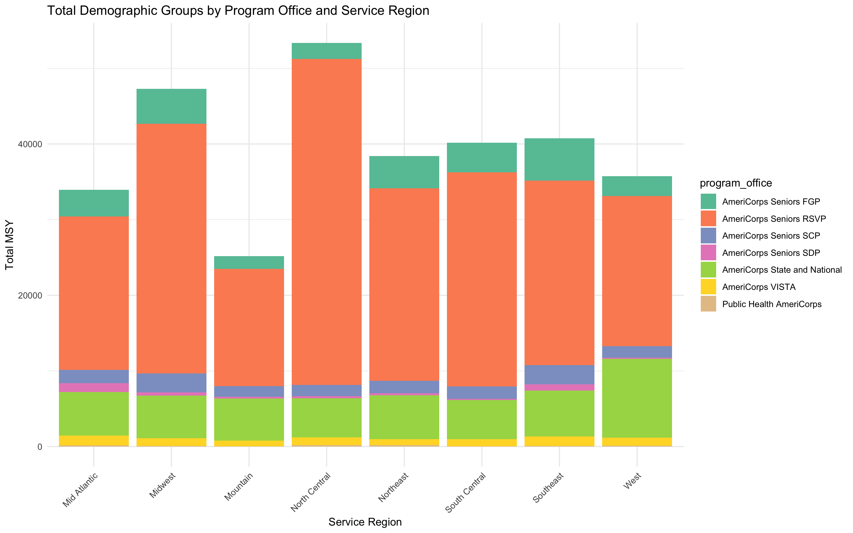
How do participation rates compare between different programs within the same service region?
Notes:
This slide is not race based, just program office by region.
NCCC is missing because it has less than 2000 total MSYs.
RSVP volunteers massively outnumber the rest.

Slide 10
The questions we couldn’t answer
How does the representation of different demographic groups compare to their proportions in the general population?
Which groups are overrepresented or underrepresented in AmeriCorps?
Notes:
The purpose of this data is for AmeriCorps to be able to determine how well they are doing recruiting a volunteer force that is representative of the communities they serve. Although they do determine and provide in these results in the data, we were unable to understand how they were comparing Member Service Years to actual counts of people. We used the available open-source analysis procedure documents provided with the data set, but ultimately, there were inconsistencies in the way the numbers were recorded in the data that we could not explain. For example, the Census Population Total numbers were different between different observations for the same state. We concluded that if we worked for the agency and could ask those clarifying questions, the data would likely support answering these questions. But without understanding that conversion element from MSYs to counts, in order to then be able to reference census population numbers, we could not.

Slide 11
Additional notes about our data set
2 time periods: 2020-2022 or 2022*
Demographic categories
Race*
Ethnicity (Hispanic or Not)
Sex
Socioeconomic status (Mother’s ed)
Summary rows included
All AmeriCorps Volunteers
Summaries for all Seniors programs
Non-white
National, Regional, State
Notes:
This was a very large dataset with wide ranging information included. A particularly tricky element was the inclusion of summary rows. Inclusion of these rows in our initial examination of the data caused duplicate entries and incorrect evaluations.

Slide 12
Conclusions
The overall distribution of race within AmeriCorps programs seems reflective of the distribution of race in the country at large.
AmeriCorps Seniors programs, especially RSVP, recruit most of the volunteers across the country.
Using a dataset without the ability to ask the researcher about how they collected and calculated the results made it a challenge to answer all the questions.

